Slide 1



THEORY
Training Program 1:
Advanced NLP & Large Language Models (LLMs)
M01: Text Preprocessing
M02: Word and Sentence Embeddings
M03: Transformer Architectures
M04: Entity-Centric NLP
M05:Applied NLP Tasks
M06: Multimodal NLP
M07: LLM Fundamentals
M08: Prompt Engineering
M09: Fine-Tuning & PEFT
M10: RAG & Real-World Projects

Slide 2
THEORY
Training Program 1:
Advanced NLP & Large Language Models (LLMs)
1. Getting Started with Text Processing
2. Fundamentals of Tokenization
3. Byte-Pair Encoding (BPE) and Subword Tokenization
4. Advanced Subword Tokenization with SentencePiece
5. Stopwords and Vocabulary Management
6. Processing Multilingual and Cross-Lingual Text
7. Summary and Next Steps

Slide 3
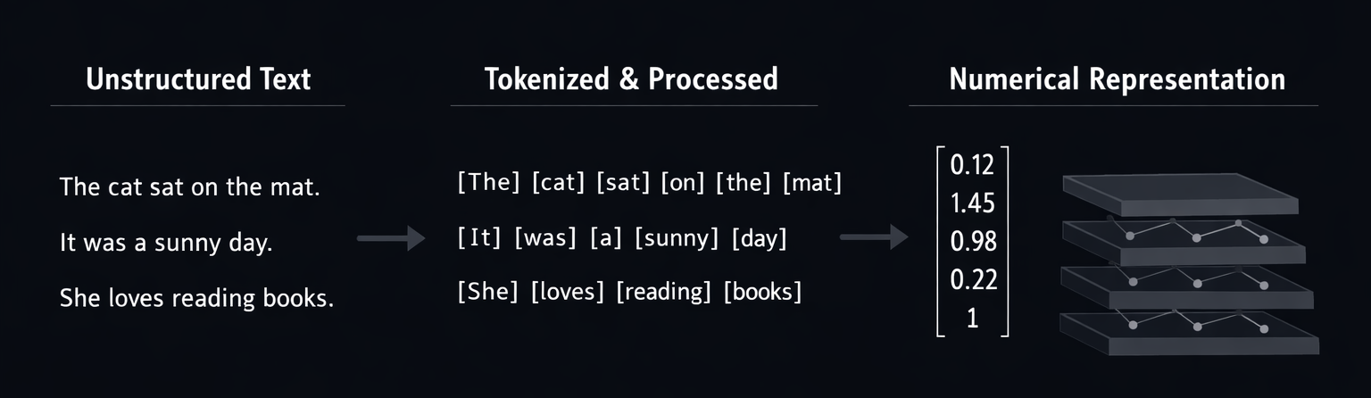
M01.1 BPE
Chapter 1.1 – Getting Started with Text Processing
Text processing is not a preliminary task, but the foundation of all modern NLP systems.
Before any model can learn, raw human language must be transformed into a structured numerical form.
This transformation defines what a model can and cannot understand.

Slide 4
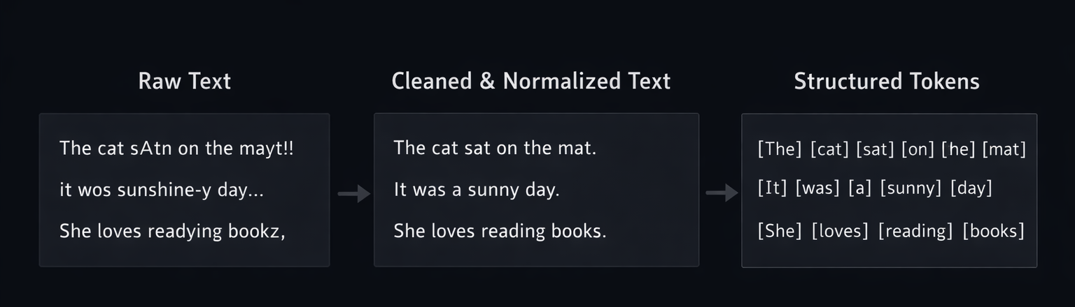
M01.1 BPE
M01 → Chapter 1.1 – Getting Started with Text Processing
The goal of preprocessing is to convert raw text into structured, machine-readable units,
while preserving as much semantic and structural information as possible.
This step determines the quality and limits of the entire model.

Slide 5
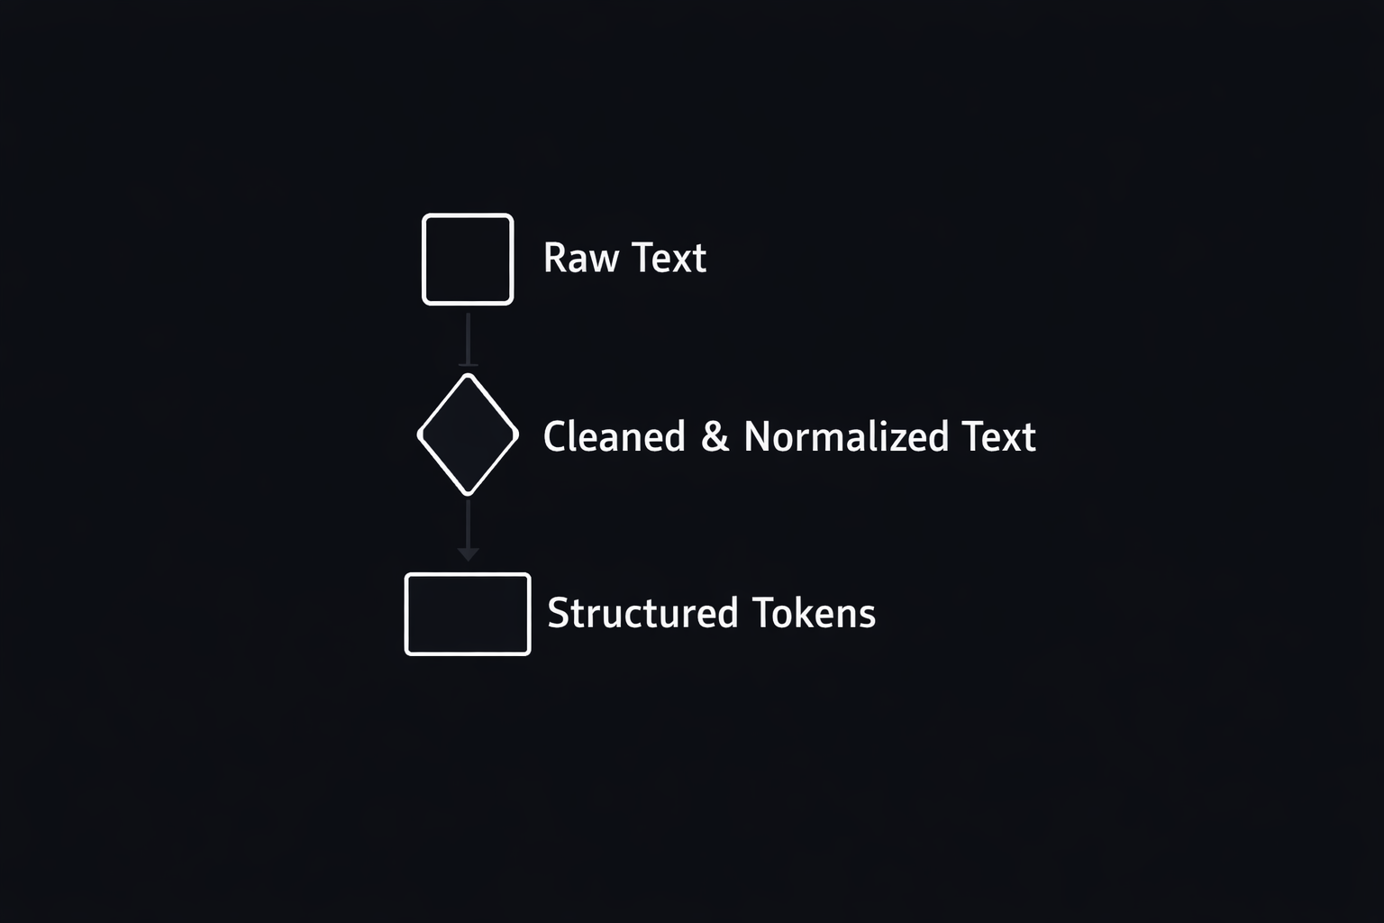
M01.1 BPE
M01 → Chapter 1.1 – Getting Started with Text Processing
• Cleaning and normalization of noisy text
• Definition of tokens and vocabulary
• Preparation for numerical embedding and vectorization

Slide 6
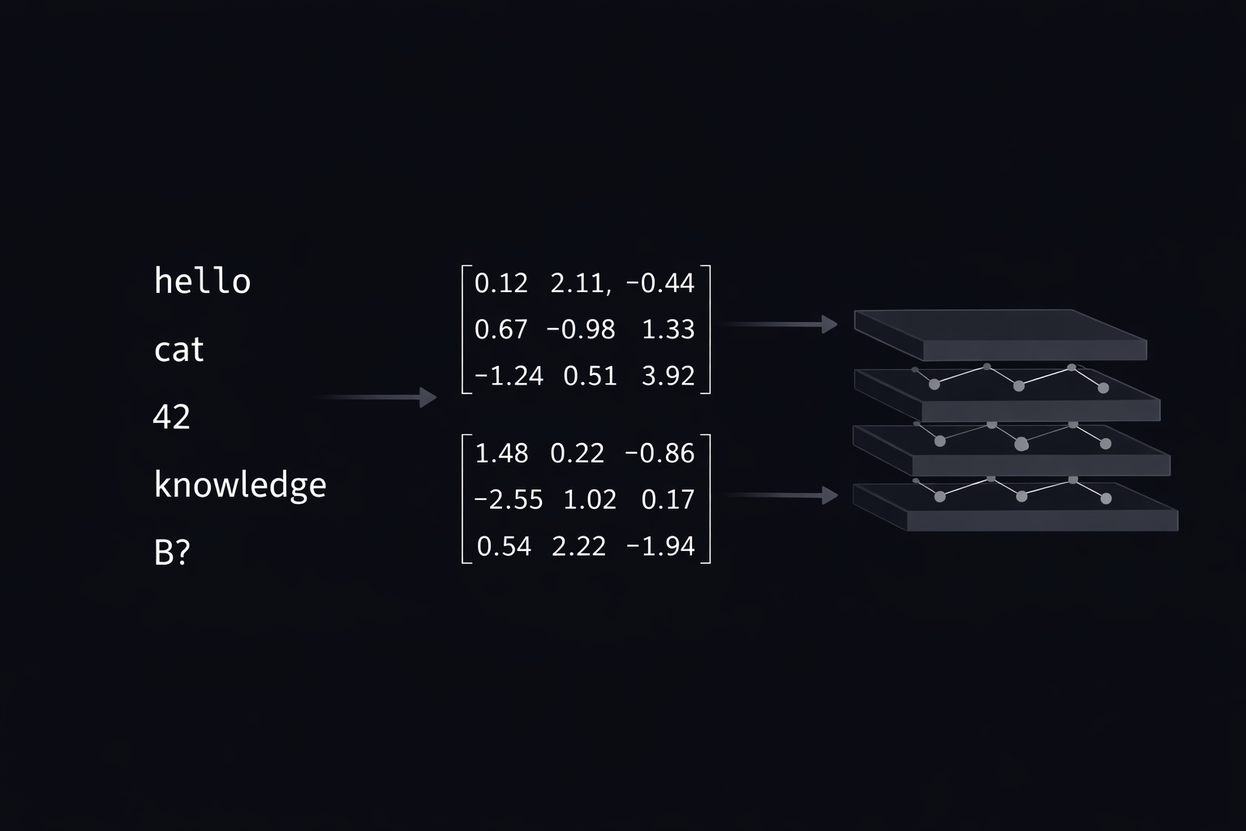
M01.1 BPE
M01 → Chapter 1.1 – Getting Started with Text Processing
Neural networks do not understand symbols or words.
They operate exclusively on numerical tensors.
Preprocessing defines how language is translated into numbers, and therefore defines the model’s perception of reality.

Slide 7
THEORY
Training Program 1:
Advanced NLP & Large Language Models (LLMs)
1. Getting Started with Text Processing
2. Fundamentals of Tokenization
3. Byte-Pair Encoding (BPE) and Subword Tokenization
4. Advanced Subword Tokenization with SentencePiece
5. Stopwords and Vocabulary Management
6. Processing Multilingual and Cross-Lingual Text
7. Summary and Next Steps

Slide 8
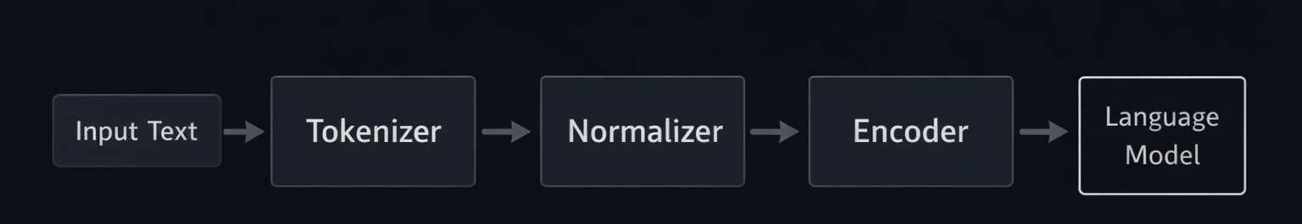
M01.1 BPE
Chapter 1.2 – Fundamentals of Tokenization
Modern LLM pipelines rely on highly optimized libraries to ensure efficiency, consistency, and reproducibility.
These tools define how text becomes training-ready data.

Slide 9
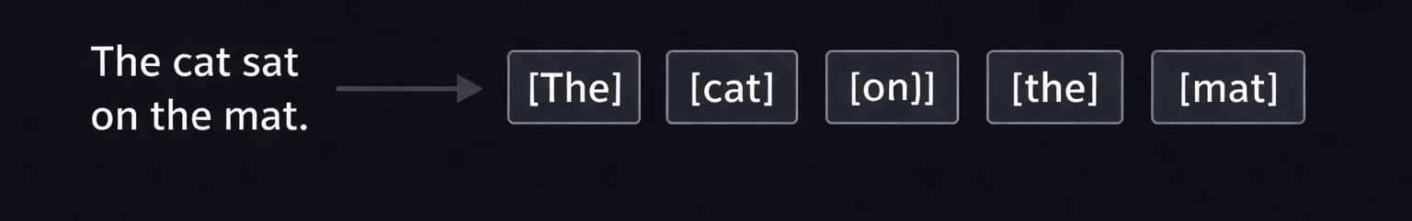
M01.1 BPE
Chapter 1.2 – Fundamentals of Tokenization
Tokenization is the deterministic process of splitting text into discrete units called tokens.
These tokens are the atomic elements used by language models to represent and process human language.

Slide 10
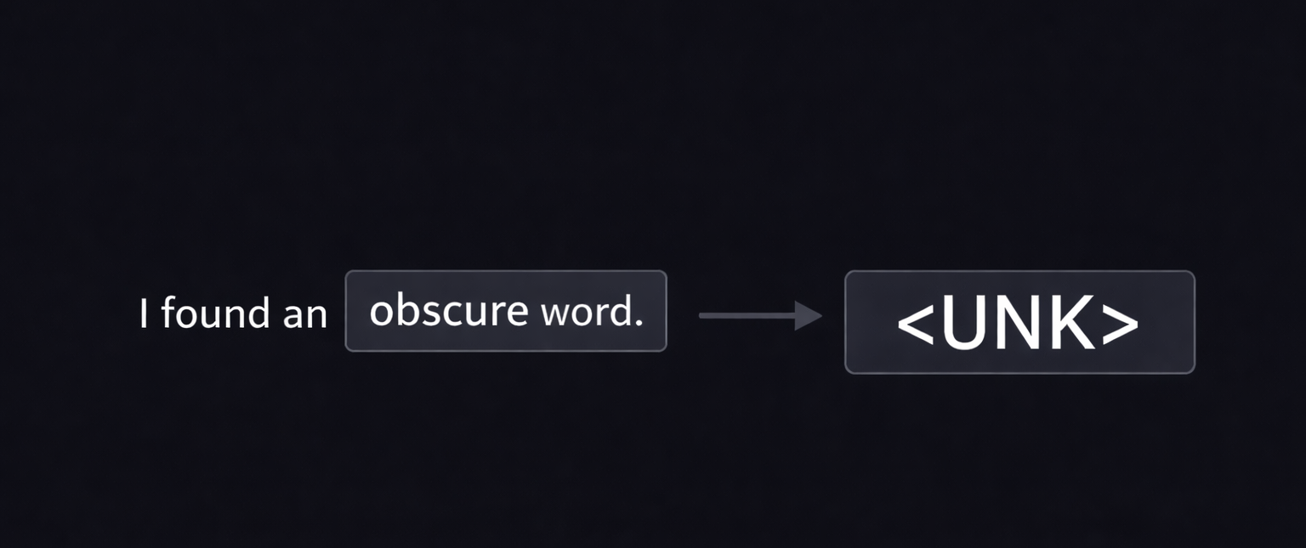
M01.1 BPE
Chapter 1.2 – Fundamentals of Tokenization
Word-level tokenization fails when encountering words that are not present in the training vocabulary.
These unknown tokens reduce model performance and limit generalization to new data.

Slide 11
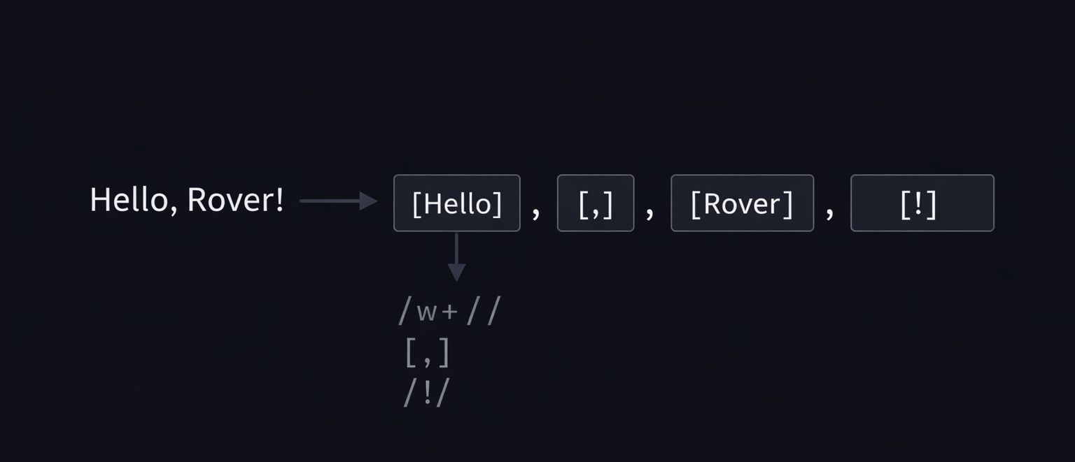
M01.1 BPE
Chapter 1.2 – Fundamentals of Tokenization
Rule-based tokenizers use predefined patterns to split text while preserving punctuation and structure.
Regular expressions allow precise control over how symbols, spaces, and contractions are handled.

Slide 12
THEORY
Training Program 1:
Advanced NLP & Large Language Models (LLMs)
1. Getting Started with Text Processing
2. Fundamentals of Tokenization
3. Byte-Pair Encoding (BPE) and Subword Tokenization
4. Advanced Subword Tokenization with SentencePiece
5. Stopwords and Vocabulary Management
6. Processing Multilingual and Cross-Lingual Text
7. Summary and Next Steps

Slide 13
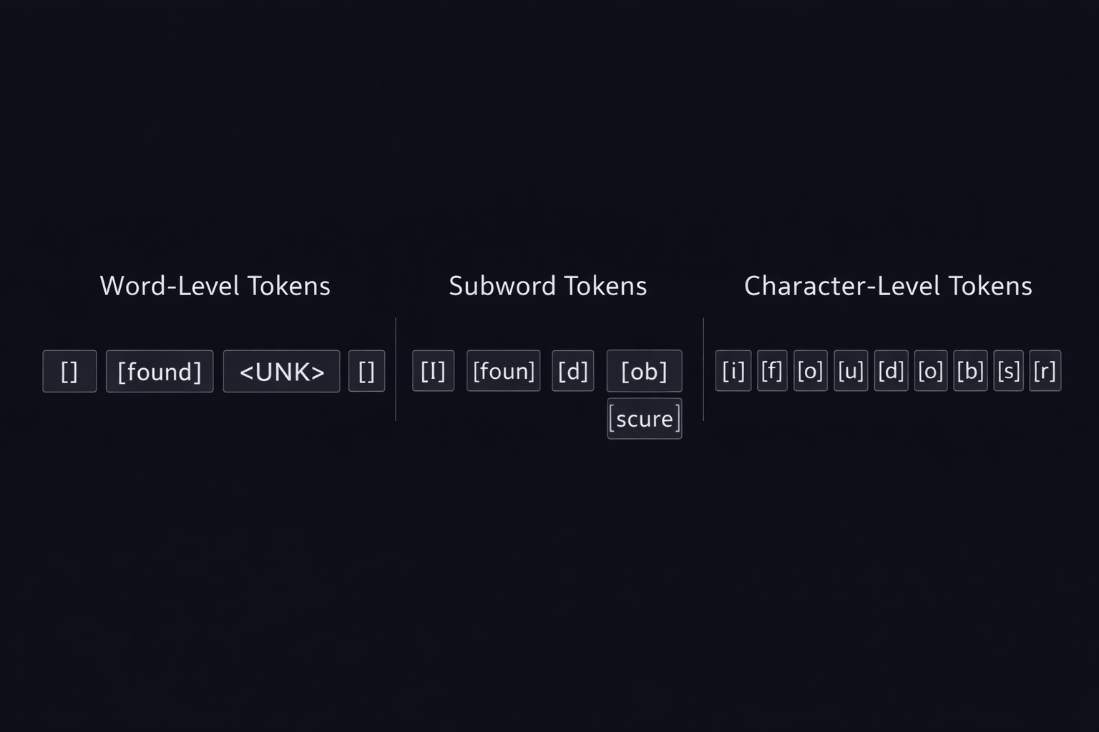
M01.1 BPE
Chapter 1.3 – Byte-Pair Encoding (BPE) and Subword Tokenization
Subword tokenization was introduced to balance the limitations of word-level and character-level approaches.
It enables models to represent any word while preserving meaningful linguistic units.

Slide 14
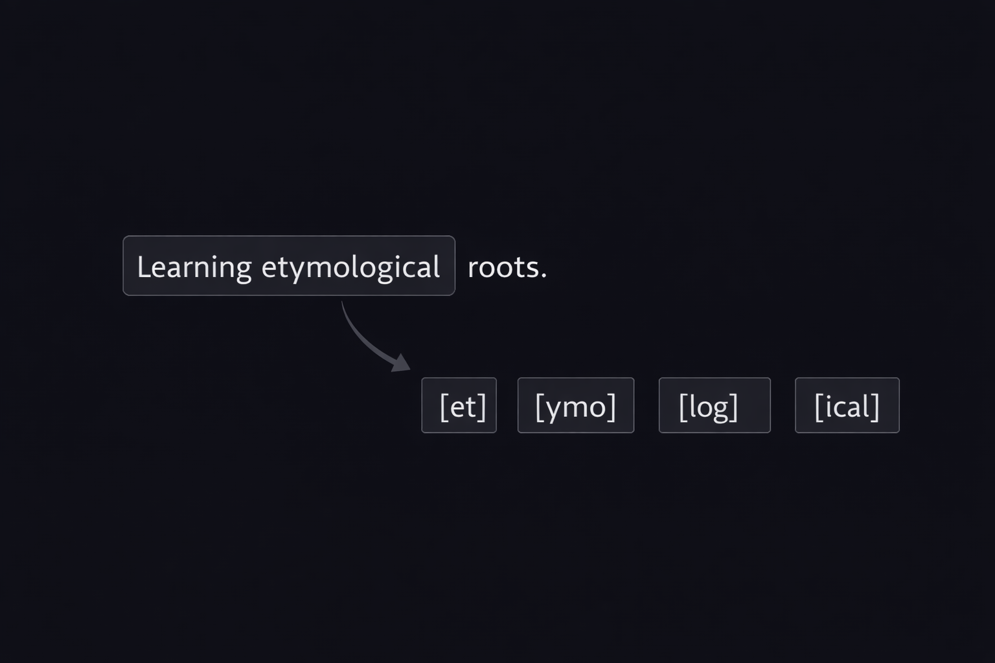
M01.1 BPE
Chapter 1.3 – Byte-Pair Encoding (BPE) and Subword Tokenization
Handling the Out-of-Vocabulary (OOV) Problem
• Word-level tokenization fails on unseen or rare words
• Unknown tokens reduce model accuracy and robustness
• Subword tokenization decomposes unknown words into known units
• This guarantees full coverage of any input text

Slide 15
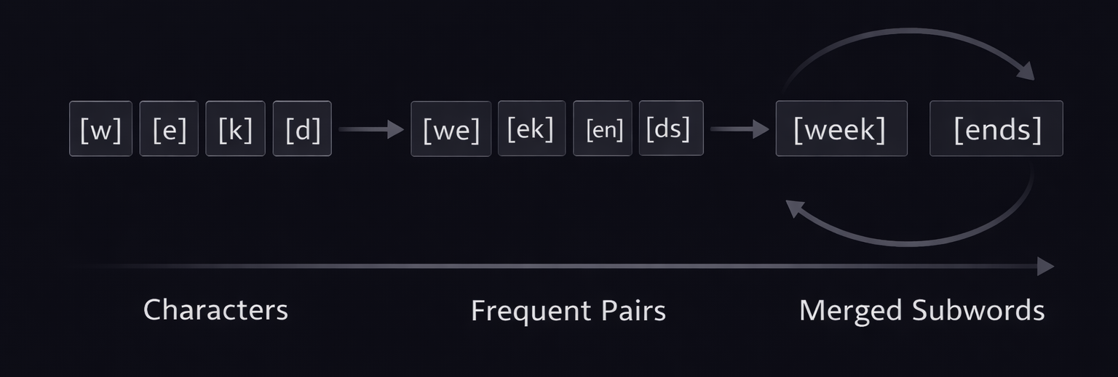
M01.1 BPE
Chapter 1.3 – Byte-Pair Encoding (BPE) and Subword Tokenization
What Is Byte-Pair Encoding (BPE)?
• Byte-Pair Encoding is an iterative subword tokenization algorithm
• It is based on frequency statistics from the training corpus
• The algorithm merges the most frequent adjacent token pairs
• Over time, meaningful subword units are learned

Slide 16
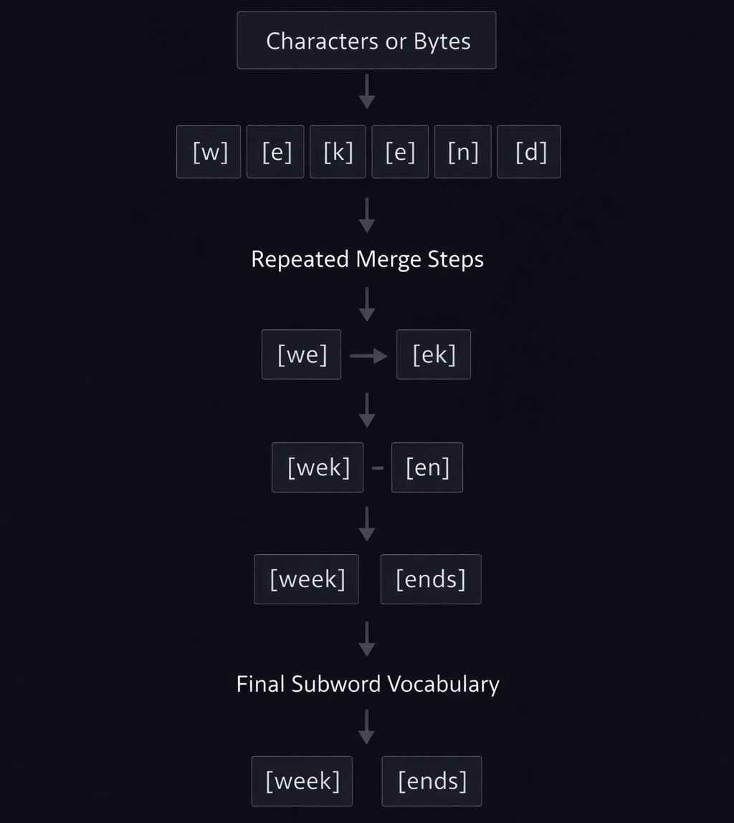
M01.1 BPE
Chapter 1.3 – Byte-Pair Encoding (BPE) and Subword Tokenization
The BPE Training Process
• Training starts from individual characters or bytes
• All adjacent token pairs are counted across the dataset
• The most frequent pair is merged into a new token
• The process repeats until the target vocabulary size is reached

Slide 17
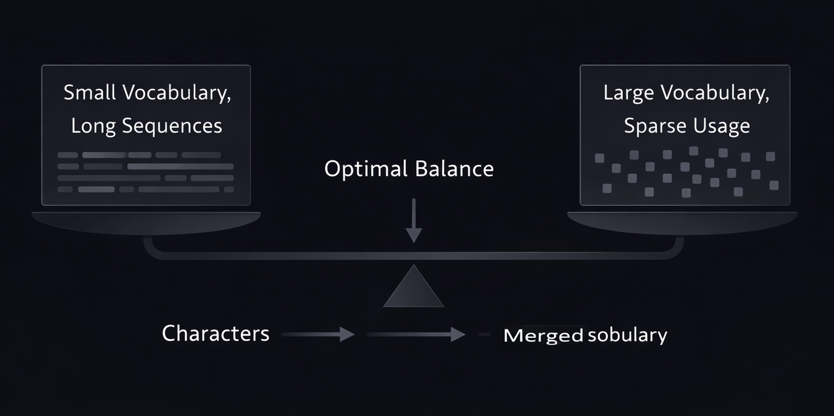
M01.1 BPE
Chapter 1.3 – Byte-Pair Encoding (BPE) and Subword Tokenization
Vocabulary Size Trade-Offs in BPE
• Small vocabularies increase sequence length
• Longer sequences raise computational cost
• Large vocabularies reduce fragmentation
• Excessively large vocabularies introduce sparsity
• Vocabulary size is a key design decision

Slide 18
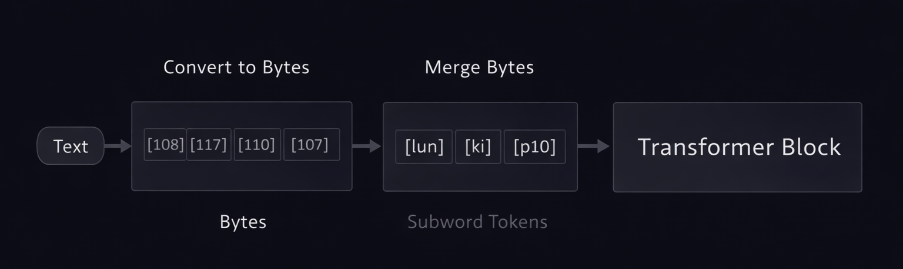
M01.1 BPE
Chapter 1.3 – Byte-Pair Encoding (BPE) and Subword Tokenization
BPE in Transformer and GPT-Style Models
• Modern Transformer models rely on subword tokenization
• Byte-level BPE ensures a fixed and complete base vocabulary
• This approach handles any character or symbol
• It enables efficient and scalable language modeling

Slide 19
THEORY
Training Program 1:
Advanced NLP & Large Language Models (LLMs)
1. Getting Started with Text Processing
2. Fundamentals of Tokenization
3. Byte-Pair Encoding (BPE) and Subword Tokenization
4. Advanced Subword Tokenization with SentencePiece
5. Stopwords and Vocabulary Management
6. Processing Multilingual and Cross-Lingual Text
7. Summary and Next Steps

Slide 20
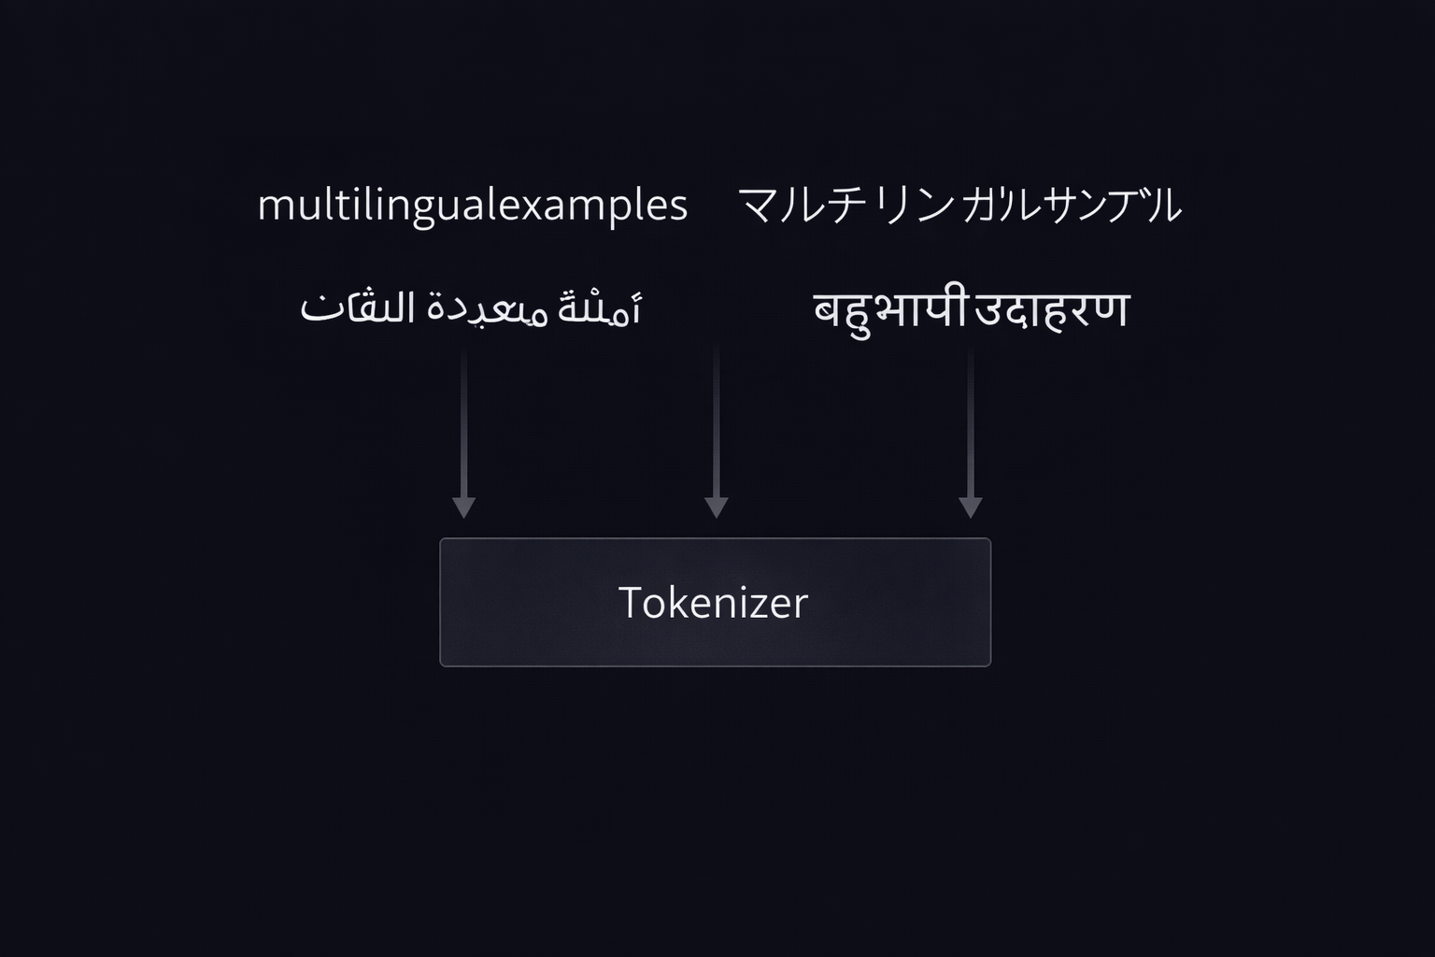
M01.1 BPE
Chapter 1.4 – SentencePiece
Why SentencePiece Was Introduced
• Traditional tokenizers rely on language-specific rules
• Whitespace-based pre-tokenization fails for many scripts
• SentencePiece processes text as a raw character stream
• This enables fully language-agnostic tokenization

Slide 21
THEORY
Training Program 1:
Advanced NLP & Large Language Models (LLMs)
1. Getting Started with Text Processing
2. Fundamentals of Tokenization
3. Byte-Pair Encoding (BPE) and Subword Tokenization
4. Advanced Subword Tokenization with SentencePiece
5. Stopwords and Vocabulary Management
6. Processing Multilingual and Cross-Lingual Text
7. Summary and Next Steps

Slide 22
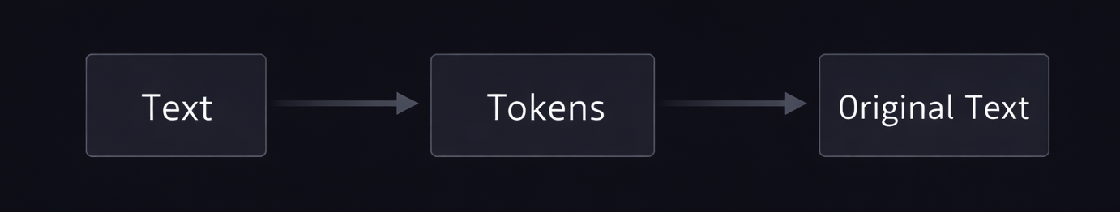
M01.1 BPE
Chapter 1.5 – Stopwords and Vocabulary Management
Stopwords in Modern NLP Systems
• Stopwords are high-frequency functional words
• Removing them was common in early NLP systems
• Transformer models rely on context and attention
• Modern pipelines often preserve stopwords

Slide 23
THEORY
Training Program 1:
Advanced NLP & Large Language Models (LLMs)
1. Getting Started with Text Processing
2. Fundamentals of Tokenization
3. Byte-Pair Encoding (BPE) and Subword Tokenization
4. Advanced Subword Tokenization with SentencePiece
5. Stopwords and Vocabulary Management
6. Processing Multilingual and Cross-Lingual Text
7. Summary and Next Steps

Slide 24
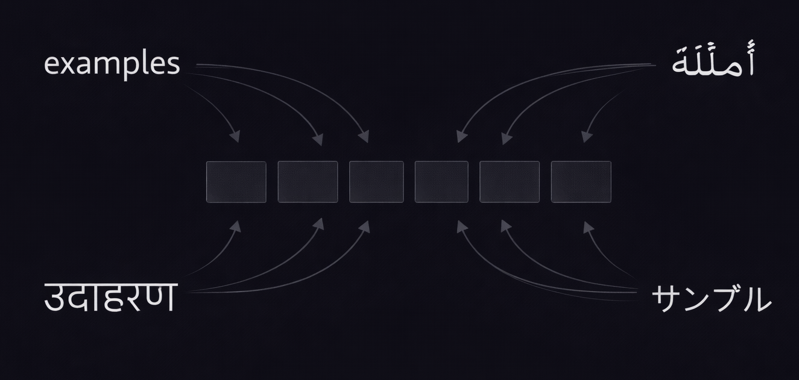
M01.1 BPE
Chapter 1.6 – Processing Multilingual and Cross-Lingual Text
Challenges of Multilingual Tokenization
• Languages differ in scripts and morphology
• Whitespace is not universal across languages
• Subword tokenization enables shared vocabularies
• This supports cross-lingual and zero-shot learning

Slide 25
THEORY
Training Program 1:
Advanced NLP & Large Language Models (LLMs)
1. Getting Started with Text Processing
2. Fundamentals of Tokenization
3. Byte-Pair Encoding (BPE) and Subword Tokenization
4. Advanced Subword Tokenization with SentencePiece
5. Stopwords and Vocabulary Management
6. Processing Multilingual and Cross-Lingual Text
7. Summary and Next Steps

Slide 26
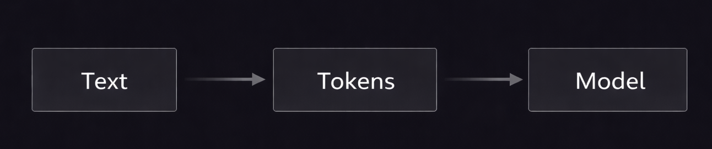
M01.1 BPE
Chapter 1.7 – Summary and Next Steps
Key Takeaways from Text Preprocessing
• Text preprocessing defines model capabilities
• Tokenization bridges language and mathematics
• Subword methods balance flexibility and efficiency
• Modern systems support multilingual inputs

Slide 27
M01.1 BPE
M01 – Text Preprocessing
Recommended References and Learning Resources
• Sebastian Raschka – Build a Large Language Model (From Scratch)
• Sennrich et al. (2016) – Neural Machine Translation of Rare Words with Subword Units
• Kudo and Richardson (2018) – SentencePiece: A Language-Independent Tokenizer
• Radford et al. (2019) – Language Models are Unsupervised Multitask Learners
• Hugging Face Course – Tokenization and NLP Fundamentals
• OpenAI Documentation – Tokenizers and tiktoken

